Slide 1
LESSON NINETEEN
TOPICS: HOW TO IMPLEMENT RANDOM OBJECT PLACEMENT AND APPEARANCE: HOW TO USE THE “RANDOM” FUNCTION.

Slide 2
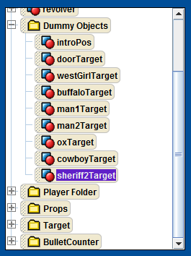
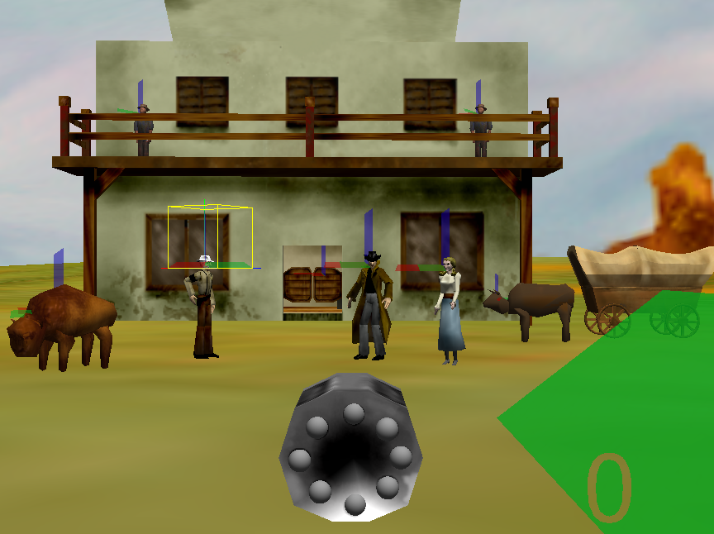
Step 1: Add Dummy Objects to Scene
Add the following dummy objects:
westGirlTarget, centered at the neck of the westGirl model
buffaloTarget, centered at the buffalo,
man1Target, centered at the neck of the man model,
man2Target, centered at the neck of the man2 model,
oxTarget, centered at the head of the wagonWithOx model,
cowboyTarget, centered at the neck of the cowboy model,
and sheriff2Target, centered at the neck of the sheriff2 model.

Slide 3
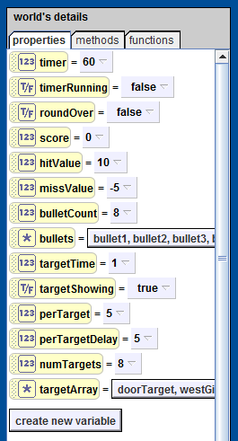
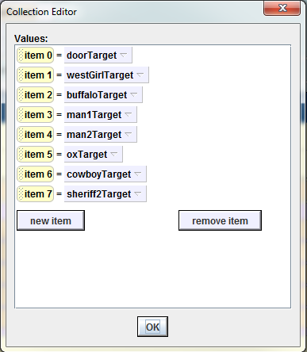
Step 2: Create Global Variables
Create a new world number variable called “numTargets”.
Set the value for numTargets to 8.
Open up the “world.placeTarget” method in the code editor.
Create a new world object array called “targetArray” and populate it with all of the target dummy objects.

Slide 4
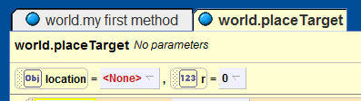
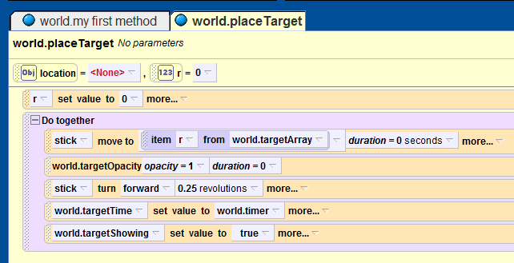
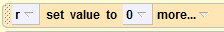
Step 3: Update the world.placeTarget Method
Create a new number variable called “r”, and set its initial value to “0”.
In the “world.placeTarget” method, replace the line
with th line
In the “world.placeTarget” method, replace the line
with th line

Slide 5
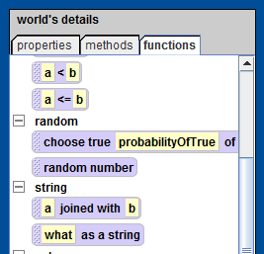
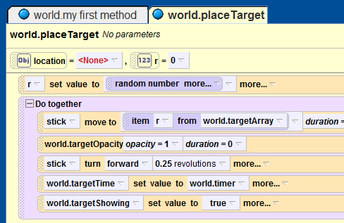
Step 4: Tell Alice to Pick a Random Target
With the world object selected, navigate to the “functions” tab and find the “random number” function under the “random” category.
Replace the zero in the first line of the “world.placeTarget” method with a call to the “random number” function.

Slide 6
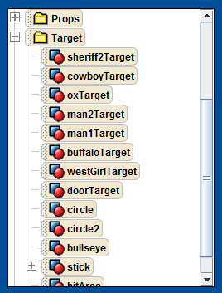
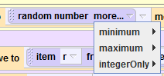
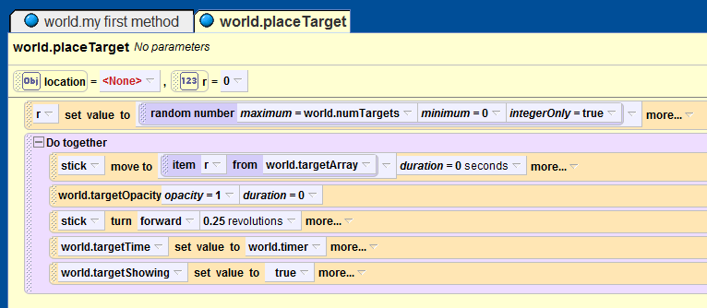
Step 5: Finishing Things Up
From the “more” drop-down-list for the “random function” select:
maximum = “world.numTargets”,
minimum = 0
IntegerOnly = true
Drag all of the Target dummy objects into the Target folder.

Slide 7
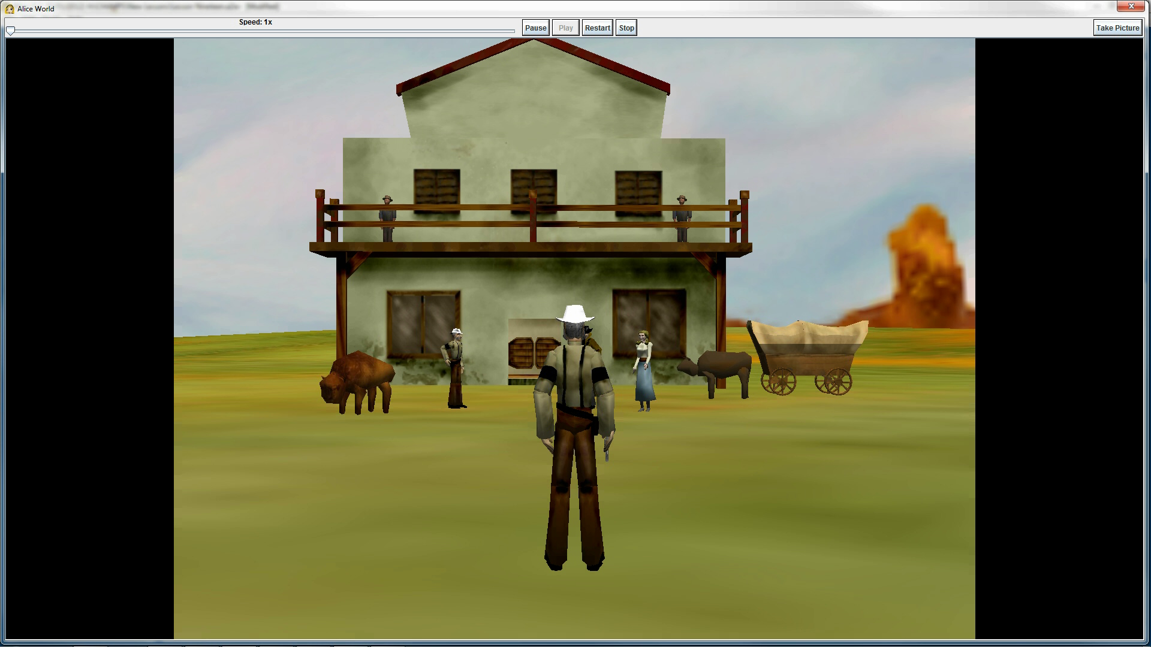
Final Scene

